Slide 1
Econometrics project
Lukas Boschet
Yann Kibamba
Omar Saip Sy

Slide 2
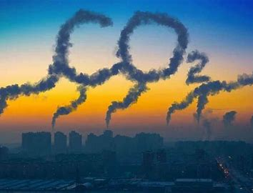
Introduction
CO2 emissions are a big threat to our planet.
Which countries emit more CO2 per capita?
Can we explain CO2 emissions thanks to economic indicators?

Slide 3


Data management
The Data
Individuals: Countries worlwide
Variables:
- CO2 : CO2 emissions per capita in metric tons
- GDP PPP per capita : GDP per capita in purchasing parity power (constant 2017 international $)
- Agricultural land : pourcentage of land area dedicated to agriculture
- Clean energy : Alternative and nuclear energy (percentage of total energy use)
- Electric power : Electric power consumption (kWh per capita)
Time period: 2003-2014
Data analysis software
Source of the data

Slide 4
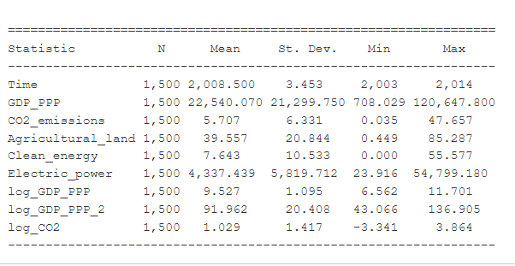
Descriptive statistics
Database Summary
125 countries
12 years
1500 observations
10 variables

Slide 5
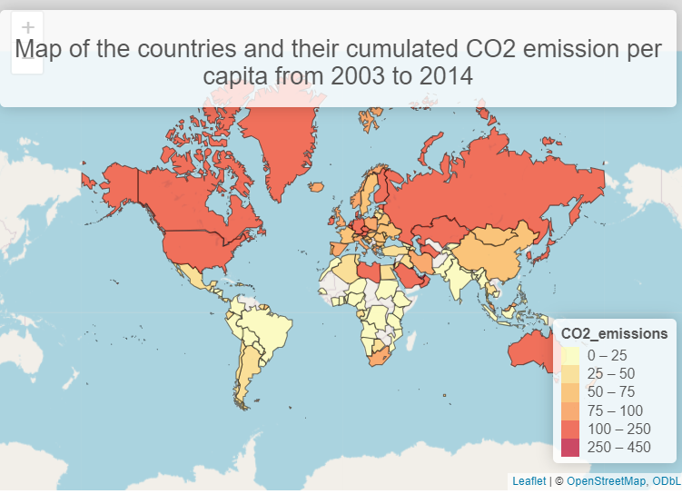
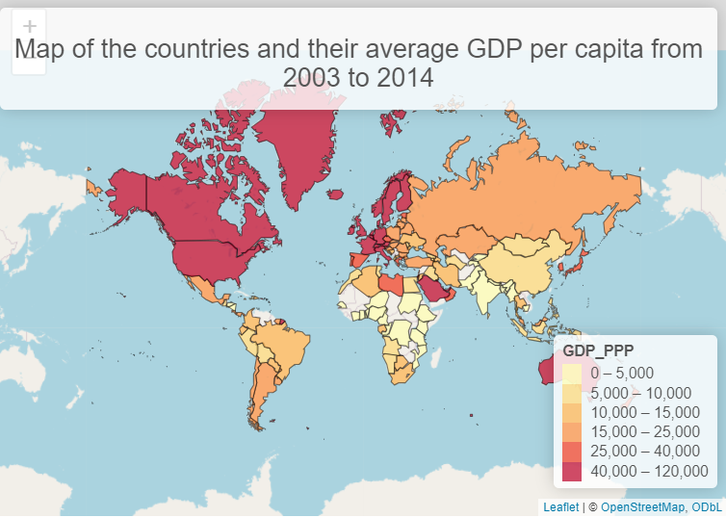
Interesting maps

Slide 6
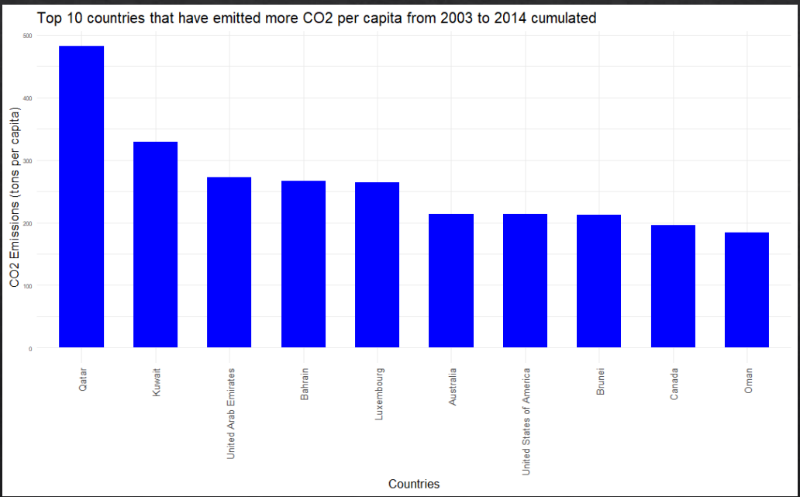
Barplot
The 10 countries which emitted more CO2 are quite diversified.
However CO2 emissions aren’t considered for a single year, but they are added up through the whole period (2003-2014).
Countries from the arabic peninsula emitted more, among the 125 countries, on that period.

Slide 7
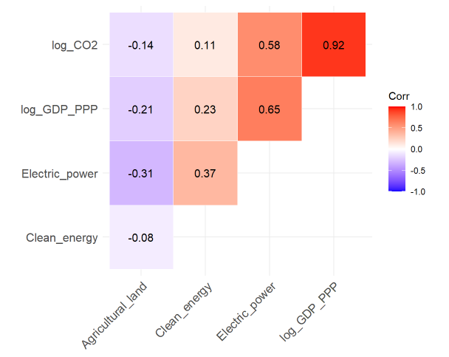
Correlation matrix
We notice that log(GDP PPP) is strongly correlated with log(CO2)
It gives an clue about the significance of log(GDP PPP) in a future model aiming to explain CO2 emissions

Slide 8
Modeling Model choice
What is the most likely here?
Each country may have individual intrisic characteristics which can influence their CO2 emissions. These intrisic characteristics, constant over time, can’t be handled with our variables.
If there is a variability of CO2 emissions depending on countries and that can’t be explained with our variables, then it just could be random noise
Fixed effects model
Random effects model

Slide 9
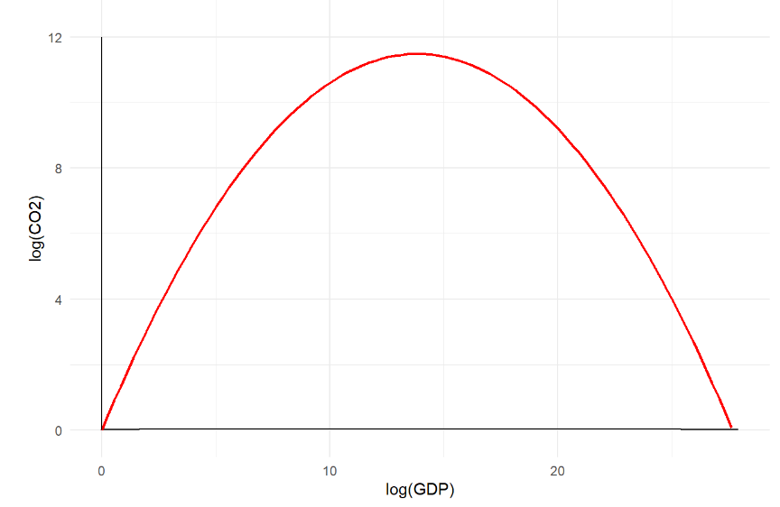

Modeling Results
Variable | Coefficient | P-value
Log(GDP PPP per capita) | 1.66 | 0.00
Log²(GDP PPP per capita) | -0.06 | 0.00
Agricultural land | 0.00 | 0.19
Clean energy | -0.02 | 0.00
Electric power | 0.00 | 0.00
Y : log(CO2)
$X_{1}$ : log(GDP PPP per capita)
$X_{2}$ : log²(GDP PPP per capita)
$X_{3}$ : Agricultural land
$X_{4}$ : Clean energy
$X_{5}$ : Electric power
$$\log\left(CO_{2}\right)=−0.66×log^{2}\left(GDP\right)+1.66×\log\left(GDP\right)$$

Slide 10
Conclusion
Our database contains 10 variables and 1500 observations
The countries that have emited more CO2 from 2003 to 2014 were: Qatar, Kuweit and the Emirates.
Our model tends to say developing countries emit more CO2 as they get richer until their wealth hits a threshold. Once this threshold gets passed, CO2 emissions start decreasing
We also studied CO2 emissions from 125 different countries

